Slide 1
Project Name : Electronic Voting Machine using 8051 microcontroller
Student name : Vedant Khodwe
Course Name : Microcontroller and Interfacing
Course code : EX2404
Roll No. : 21151245
Branch Name : SY ENTC (EX2)

Slide 2
Introduction :
Voting machines are electronic devices that enable voters to cast their votes electronically. The use of voting machines has become increasingly popular in recent years due to their ability to streamline the voting process and reduce the likelihood of errors.
The 8051 microcontroller is a popular choice for building voting machines due to its low cost, simplicity, and ease of use. In this presentation, we will explore the design and implementation of a voting machine using the 8051 microcontroller.

Slide 3
Component Analysis
Hardware Analysis :
The voting machine consists of several components, including a microcontroller, input devices (such as buttons), output devices (such as a display or speaker), and power supply. The microcontroller is responsible for controlling the overall operation of the machine.
Software Analysis :
The microcontroller is programmed using assembly language or a high-level programming language such as C. The program must be designed to read input from the buttons, display information on the screen, and count votes accurately. The program must also incorporate security measures, such as encryption and authentication, to prevent unauthorized access or manipulation of the voting data. Testing and debugging the program is an essential part of the development process to ensure that the machine operates correctly.

Slide 4
Applications
Improved Accuracy: Electronic voting machines eliminate the possibility of human error in counting votes. They ensure that the vote is recorded correctly, and the results are accurate.
Fast Results: Electronic voting machines count votes much faster than manual counting. This means that the election results can be announced much sooner, reducing the waiting time for voters.
Reduced Costs: Electronic voting machines are more cost-effective than manual counting as they require fewer staff to operate and less time to count votes.
Security: Electronic voting machines can provide better security for elections as they can be programmed to detect and prevent any attempts to tamper with the vote count.

Slide 5
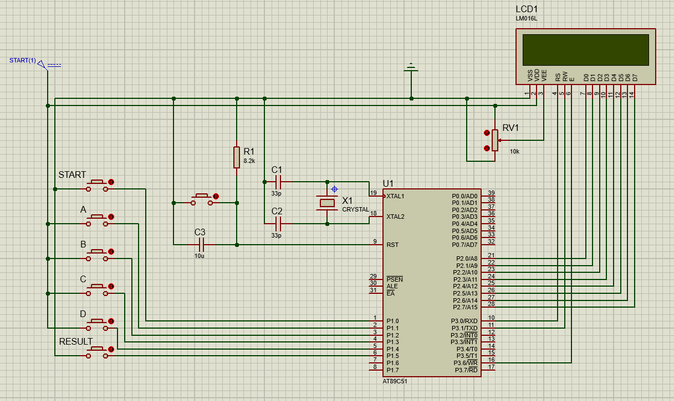
Circuit Diagram:

Slide 6
Result and Conclusion
In conclusion, the use of voting machines using 8051 microcontroller has revolutionized the way we conduct elections. These machines offer numerous advantages over traditional paper-based systems, including speed, accuracy, accessibility, and security.
While there are still concerns about the security and reliability of voting machines, ongoing testing and certification efforts are helping to address these issues. With continued development and improvement, voting machines using 8051 microcontroller have the potential to transform the way we vote and ensure fair and democratic elections.

